Slide 1

Data set Concatenation
Presented By : Baira Naveen

Slide 2
DATA SET CONCATENATION
We can retrieve two or more data sets and process them successively as a single sequential data set.
A sequential concatenation can include sequential data sets, PDS members.
Let us consider the scenario of HTC having one employee file for each branch as follows:
HTC.SJ.EMPFILE for San Jose branch
HTC.GR.EMPFILE for Grand Rapids branch
HTC.CHENNAI.EMPFILE for its SDC at Chennai, India
NOTE: All these files should be in the same format.

Slide 3
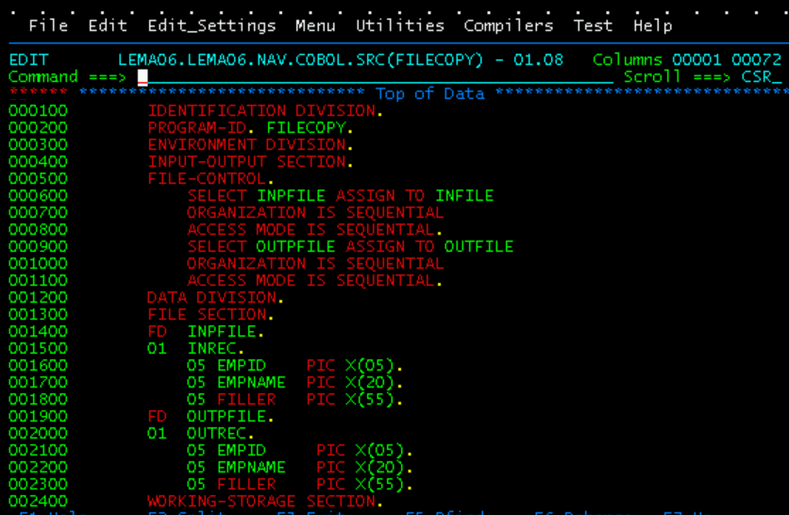
COBOL:

Slide 4
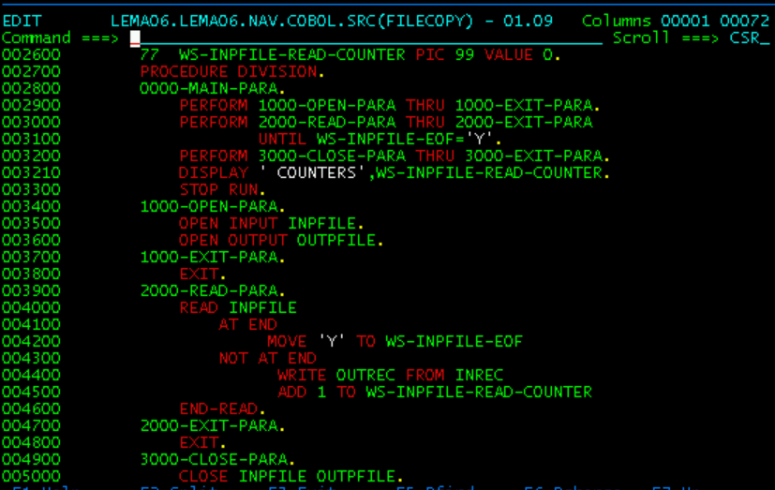

Slide 5
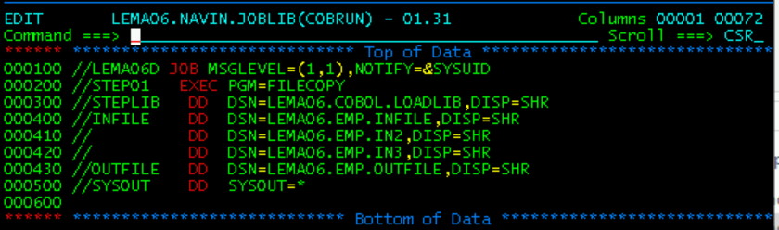
JCL PROGRAM:

Slide 6
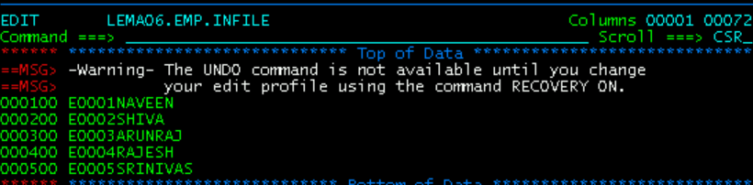
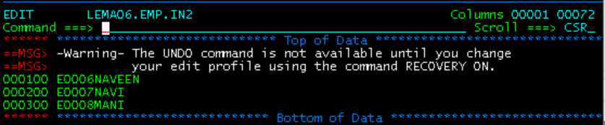
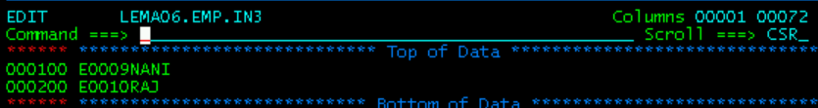
INPUT:

Slide 7
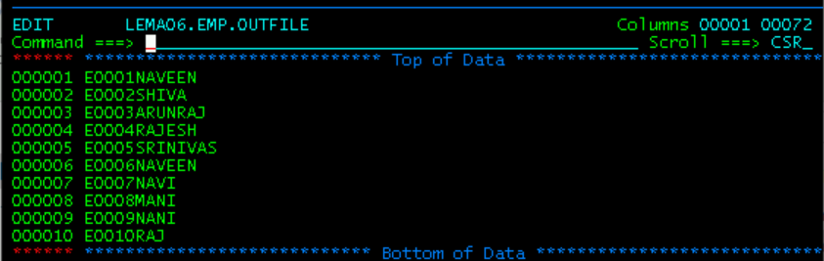
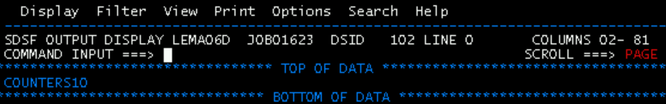
OUTPUT:

Slide 8



Thank you
Reimagine technology to
accelerate your business
www.htcinc.com
www.caretech.com
www.ciber.com

